Slide 1

All Bugs are Shallow
Open Source Drug Discovery
Prof Matthew H. Todd, University College London
@mattoddchem
EFMC-ISMC2018
September 5th 2018
Today
1) What is Open Source?
2) Open Source Malaria
3) Open Source Pharma?

Slide 2
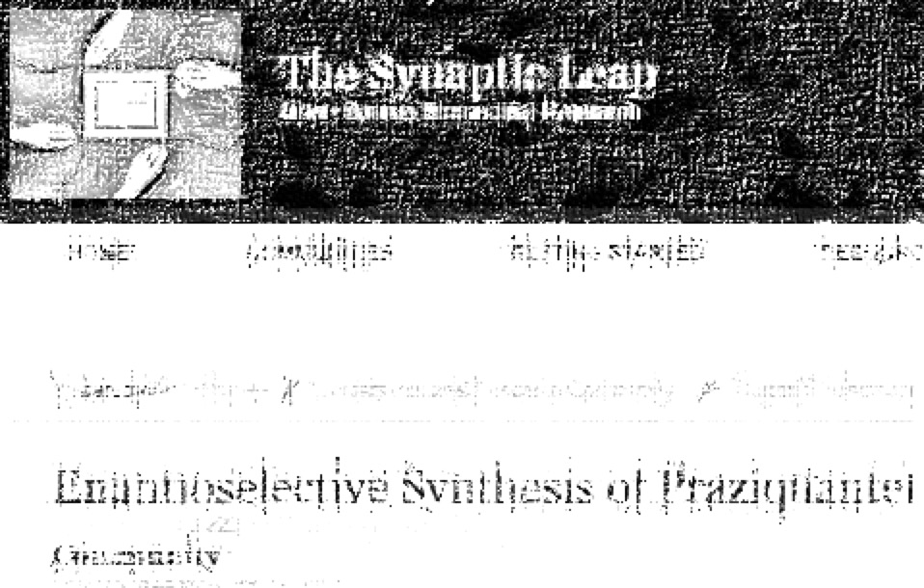
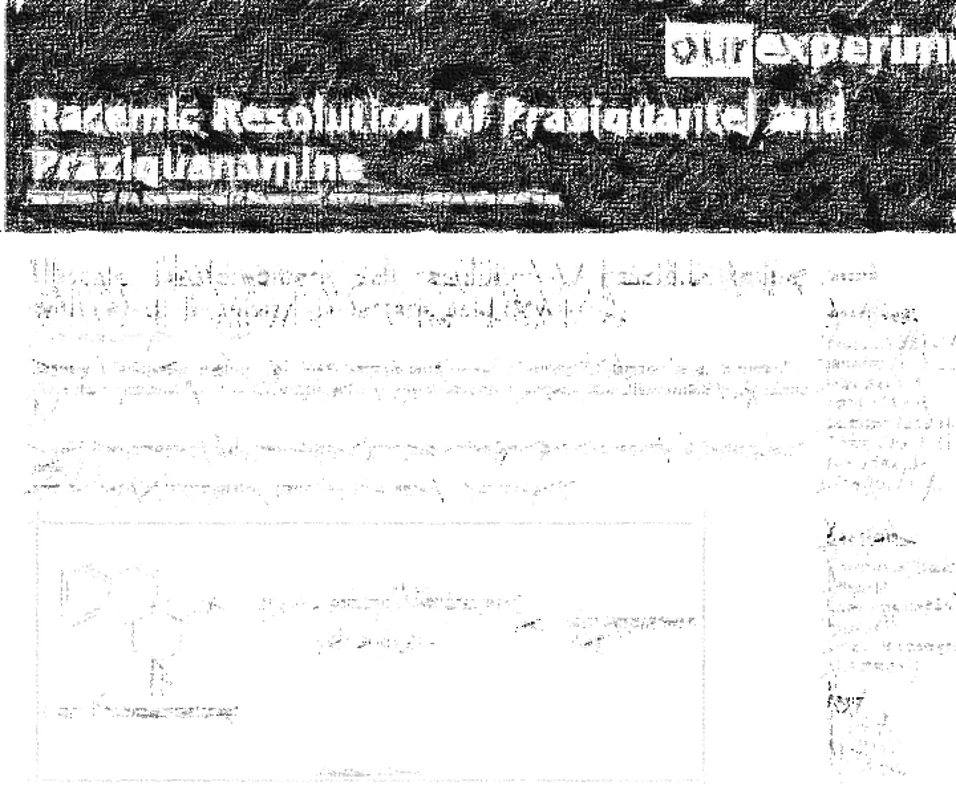
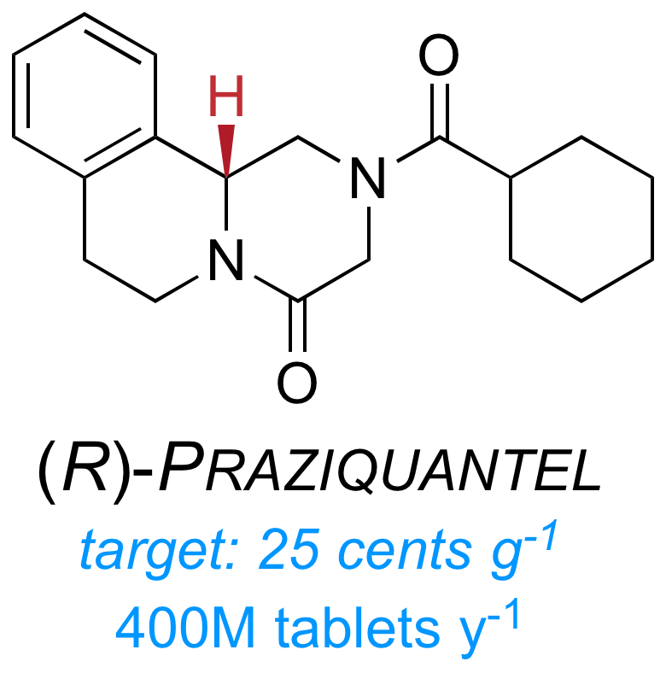
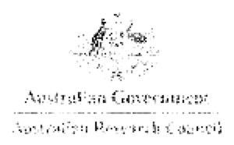
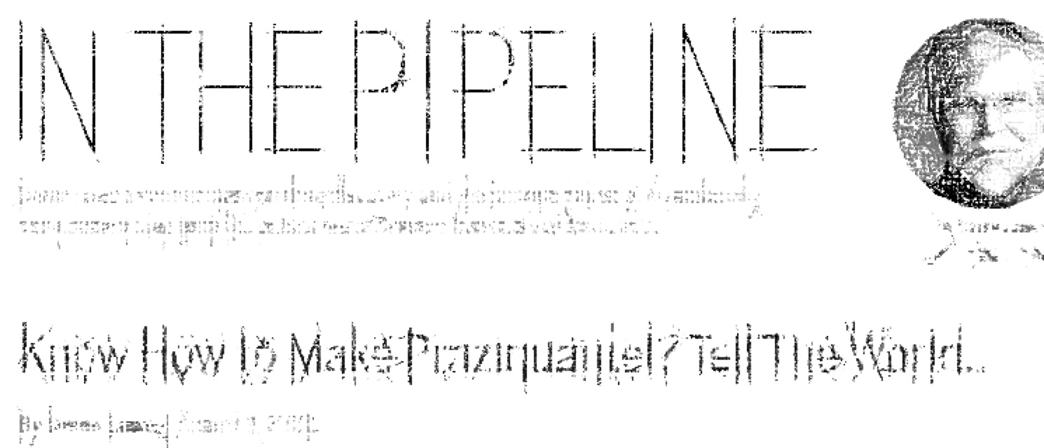
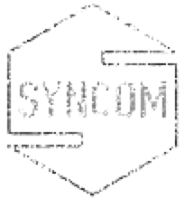
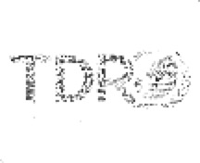
2/58
Back in the day…
Discuss What you Can’t Do
Online Lab Notebook
Community (30 ppl)
$, expertise
Awareness
Private Sector…

Slide 3
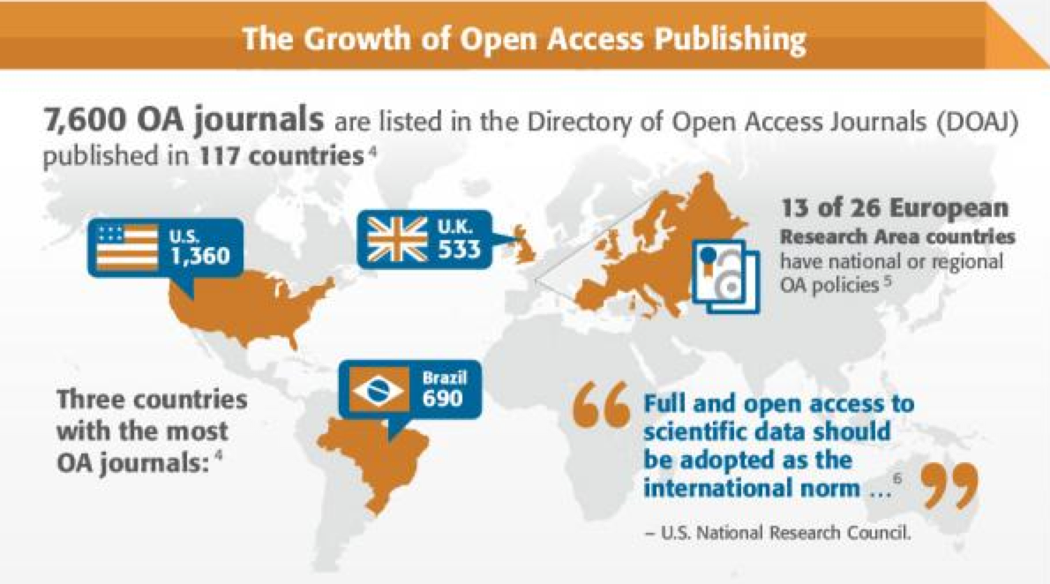
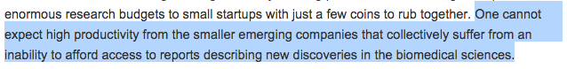
3/58
Term 1: Open Access
Can read, can re-use
“To maximise the benefits from research, publications … must be disseminated as broadly as possible to allow access by other researchers and the wider community… NHMRC therefore requires that any publication arising from NHMRC supported research must be deposited into an open access institutional repository and/or made available in another open access format within a twelve month period from the date of publication.”
http://s3.amazonaws.com/libapps/customers/1510/images/ieee_infographic.jpg
https://www.nhmrc.gov.au/grants-funding/policy/nhmrc-open-access-policy
Industry Access to the Literature, Stewart Lyman, Nature Biotech 2011, 29, 571–572. doi: 10.1038/nbt.1909
See also http://aoasg.org.au/2015/08/07/aoasg-response-to-australian-government-paper-vision-for-a-science-nation/

Slide 4
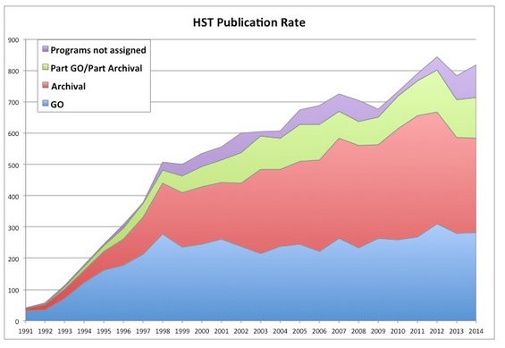
4/58
Term 2: Open Data
Power of Re-use
The Human Genome Project cost approximately $4bn, but the release of the data into the public domain created hundreds of billions in downstream scientific activity
Economic Impact of the Human Genome Project, Battelle Technology Partnership Practice, 2011
Papers from Hubble
Papers published by acquirers of data < papers published by users of the data
http://archive.stsci.edu/hst/bibliography/pubstat.html; http://archive.stsci.edu/hst/bibliography/basic_methodology.html; Thank you Andrew Treloar, ANDS
And
Piwowar HA, Vision TJ. (2013) Data reuse and the open data citation advantage. PeerJ 1:e175 https://dx.doi.org/10.7717/peerj.175
The Foundation will require that data underlying the published research results be immediately accessible and open.
Gates Foundation Open Access Policy
http://www.gatesfoundation.org/How-We-Work/General-Information/Open-Access-Policy

Slide 5

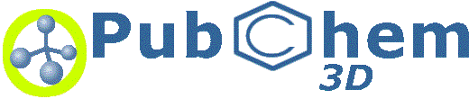
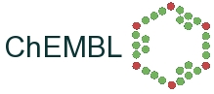
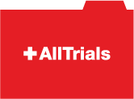

5/58
Term 2: Open Data
Who are the data for?
Houghton, J., Gruen, N. (2014) Open Research Data Report to the Australian National Data Service (ANDS). November 2014 http://ands.org.au/resource/open-research-data-report.pdf

Slide 6
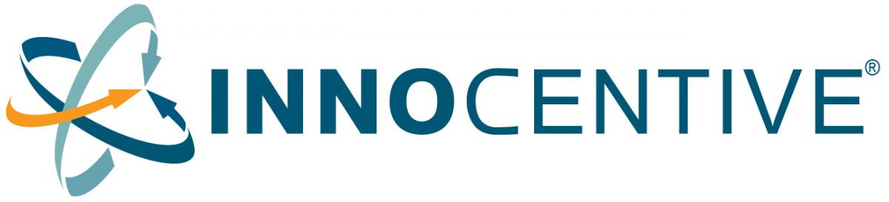

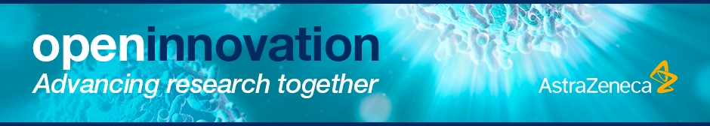

6/58
Term 2½: Open Innovation
A Nebulous Set of Ideas, Some Useful
“Open innovation is a paradigm that assumes that firms can and should use external ideas as well as internal ideas, and internal and external paths to market, as the firms look to advance their technology.”
H. W. Chesbrough, Open Innovation: The new imperative for creating and profiting from technology. Boston: Harvard Business School Press, 2003 (ISBN 978-1578518371)

Slide 7
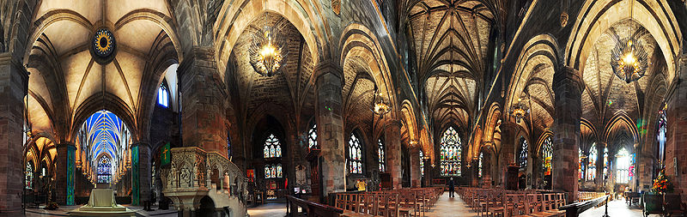
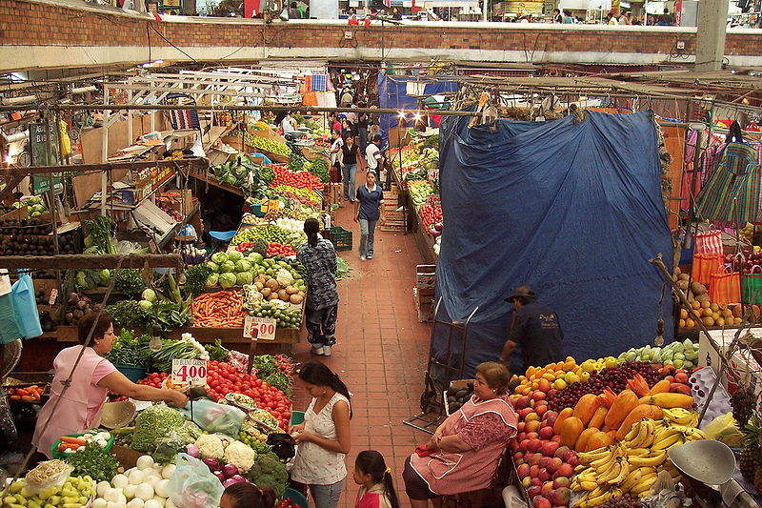
7/58
Term 3: Open Source
A Different Way of Working
http://bit.ly/9Pv119; http://bit.ly/9VTpqj

Slide 8



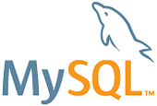
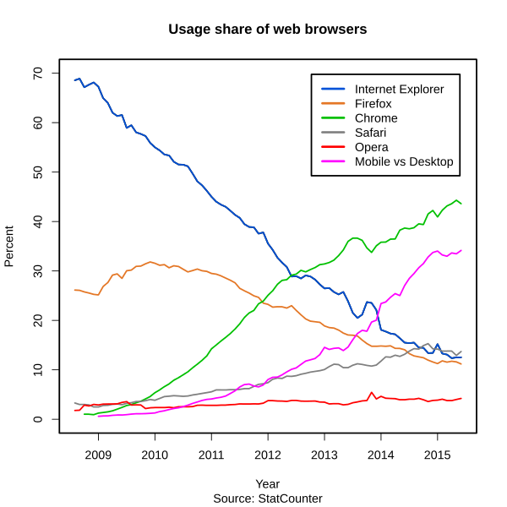

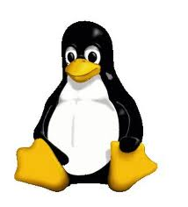
8/58
Wide Adoption of Open Source
A $5 Billion Value: Estimating the Total Development Cost of Linux Foundation’s Collaborative Projects, The Linux Foundation Report 2015 (Thanks Bill Hooker (https://twitter.com/sennoma/status/658816532147900416))
https://en.wikipedia.org/wiki/File:Usage_share_of_web_browsers_%28Source_StatCounter%29.svg

Slide 9
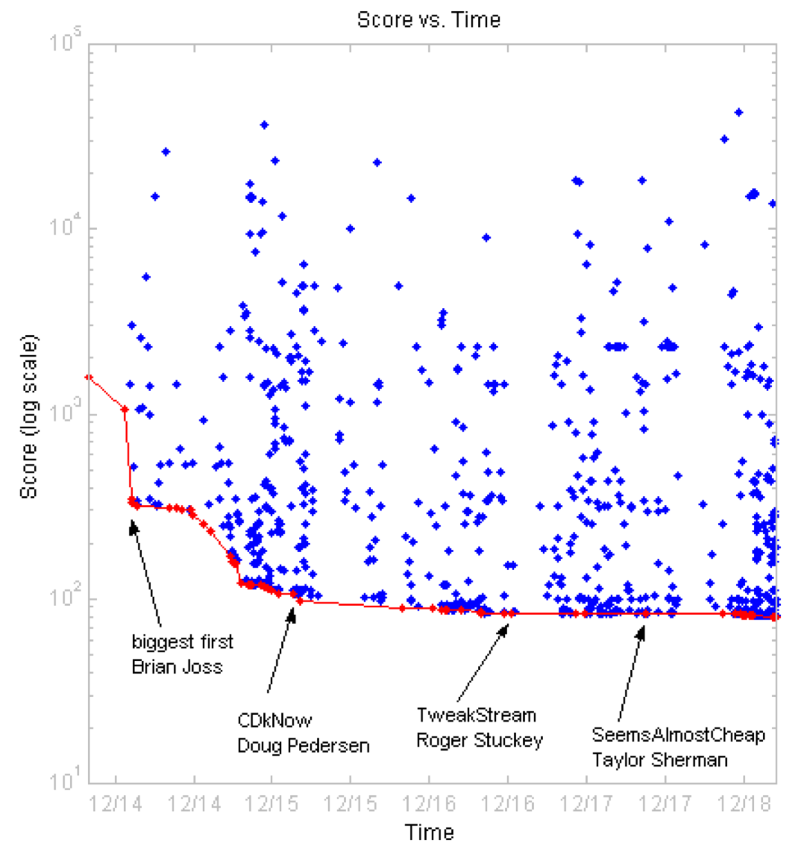
9/58
Sometimes Brutal, Frenzied
http://au.mathworks.com/matlabcentral/contest/contests/3/statistics.html

Slide 10
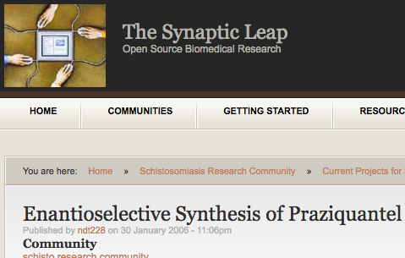
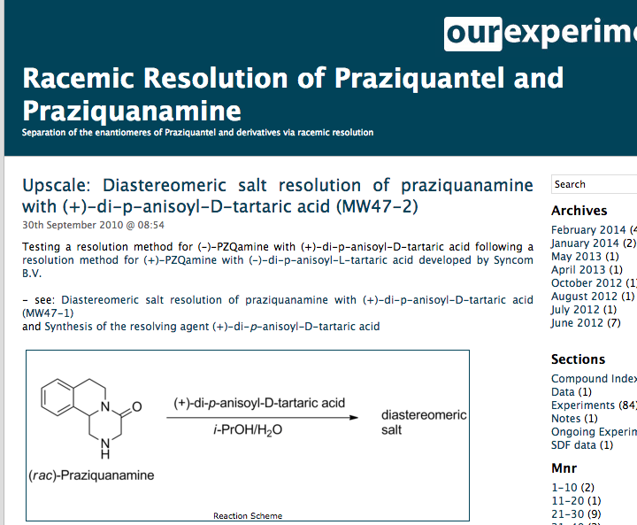

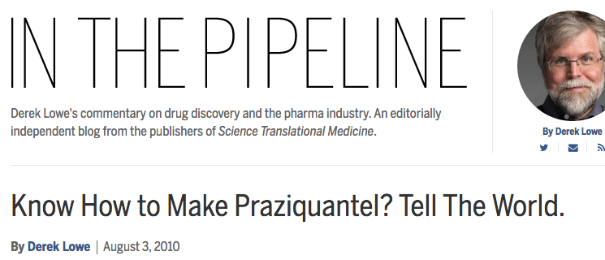


10/58
First Open Source Chemistry Project
Discuss What you Can’t Do
Online Lab Notebook
Community (30 ppl)
$, expertise
Awareness
Private Sector…

Slide 11
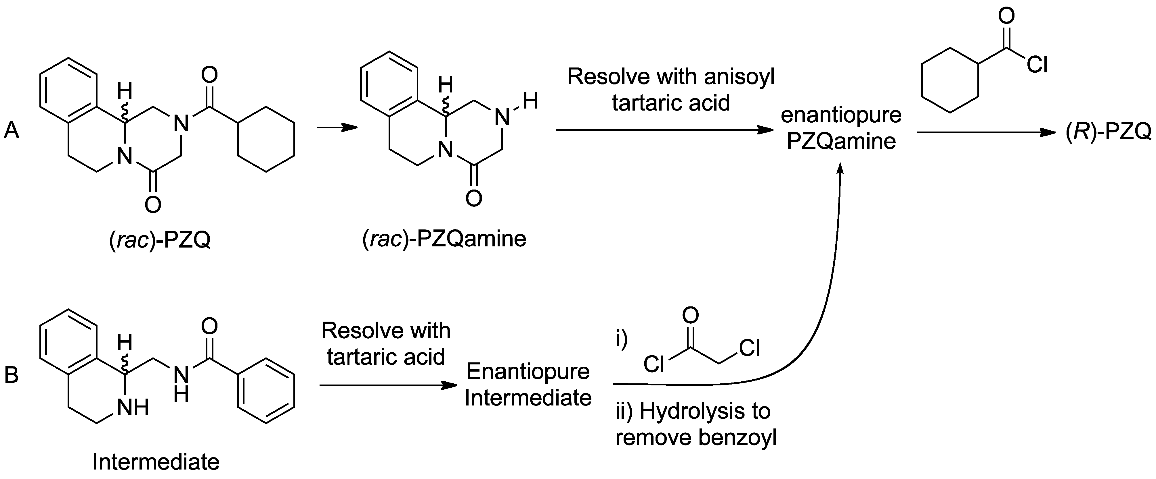

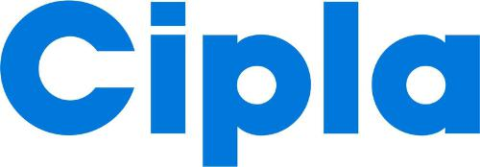
11/58
Competes with Traditional Approach
Nature Chemistry 2011, 3, 745-748; PLoS NTD 2011, 5(9): e1260

Slide 12
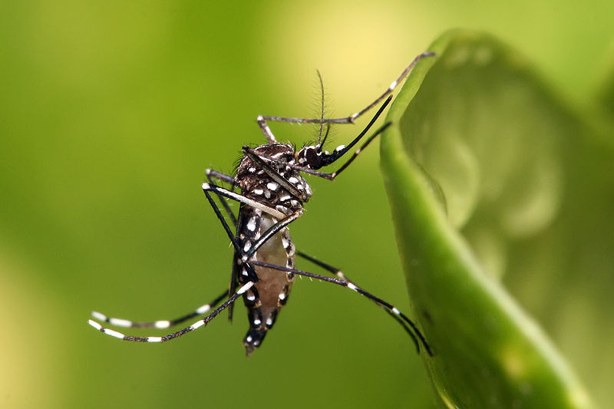



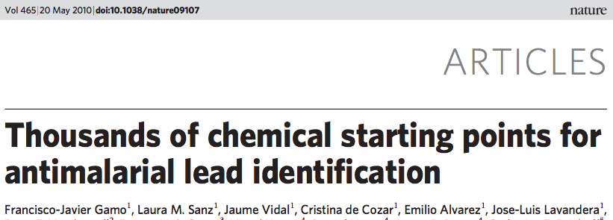


12/58
HIT
LEAD?
CONVENTIONAL DRUG DISCOVERY

Slide 13
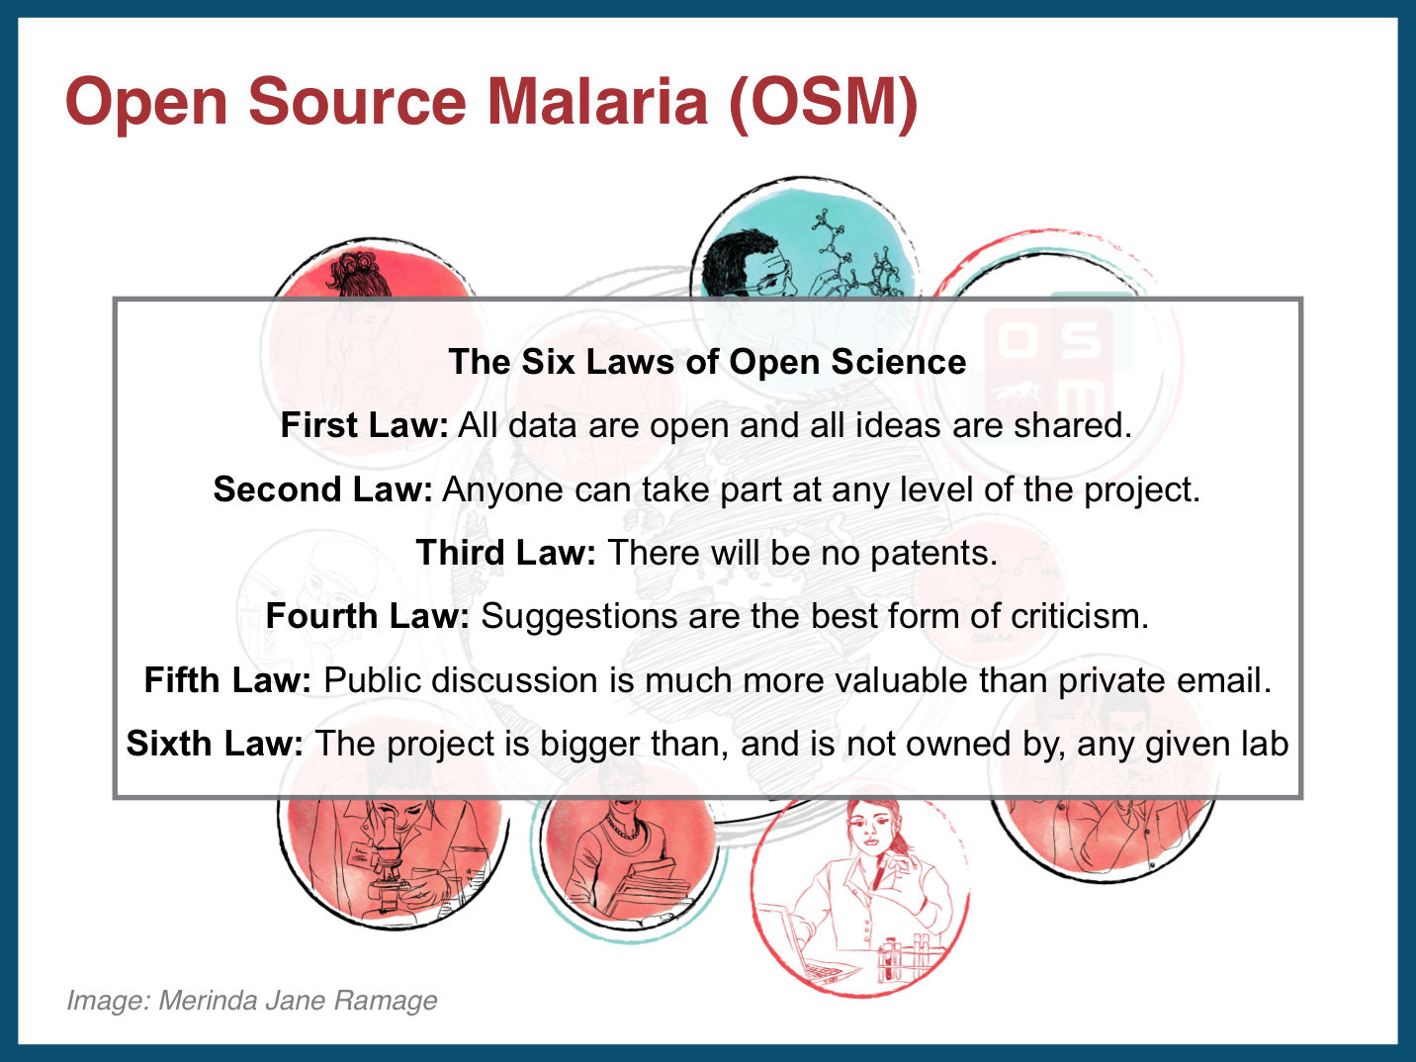
13/58

Slide 14


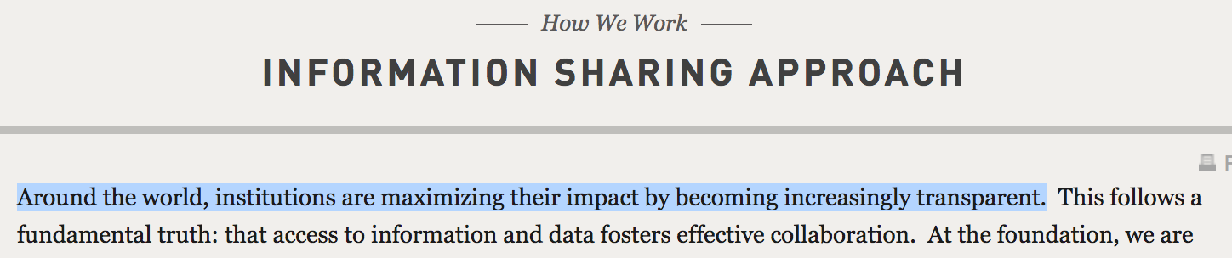
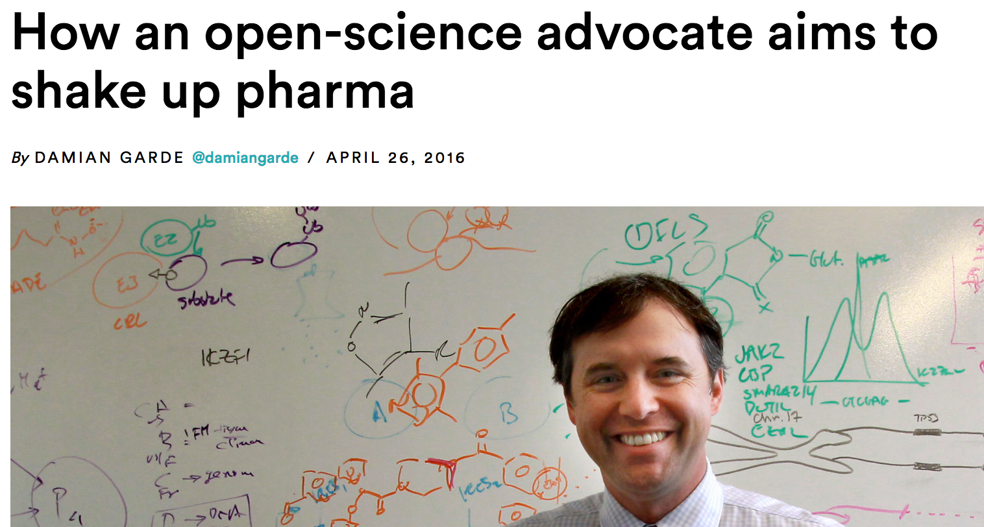
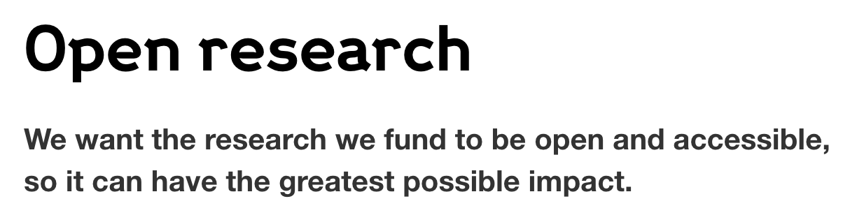
14/58
Openness Increasingly Seen as Key
Open Source Malaria
Structural Genomics Consortium
MMV’s Malaria Box
BMGF
Wellcome Trust
Novartis, Jay Bradner

Slide 15
Four Campaigns So Far
15/58
Series typically not exhausted - Decision points made to move to another.
Anyone free to employ OSM infrastructure to explore these series
www.opensourcemalaria.org, @O_S_M

Slide 16
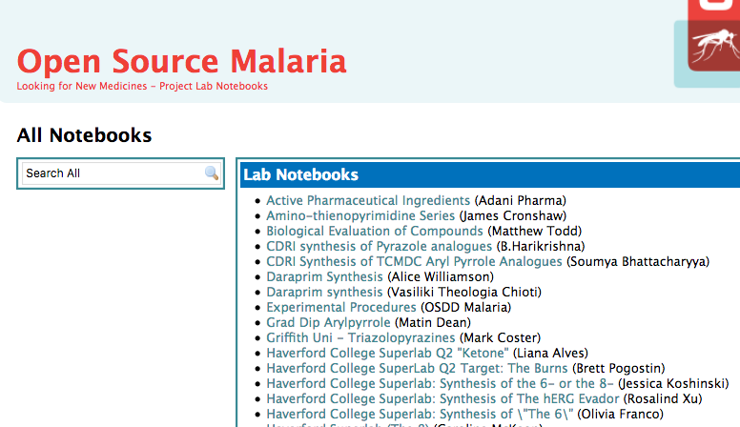
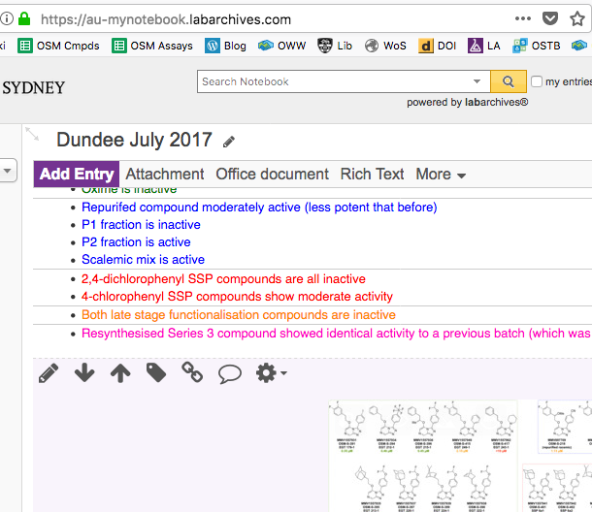
What Actually Is It?
16/58
Beta - Labarchives
Alpha - Labtrove
Electronic Lab Notebook
Real-time, open deposition of all research data. The bedrock.

Slide 17
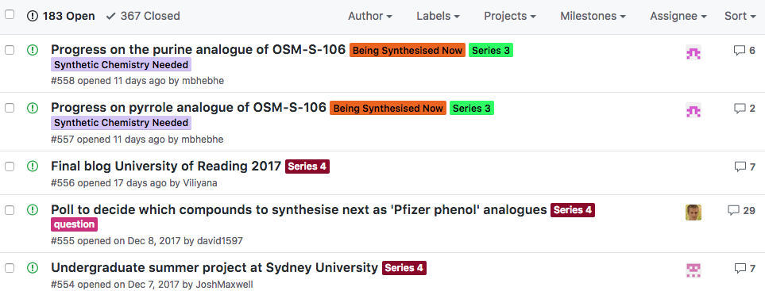
What Actually Is It?
17/58
Discussion/Wiki/To Do List
We’ve hijacked/repurposed Github, but don’t know what we’re doing
https://github.com/OpenSourceMalaria

Slide 18
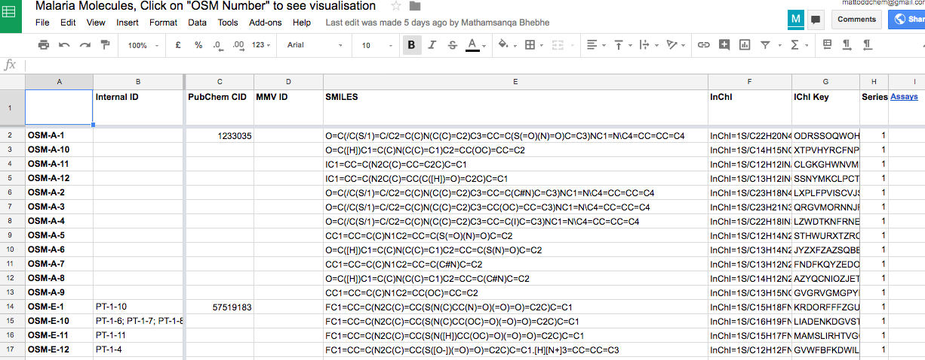
What Actually Is It?
18/58
Open Data
Details of all molecules and their potencies. Easy to reuse.
http://tinyurl.com/OSM-Compounds

Slide 19
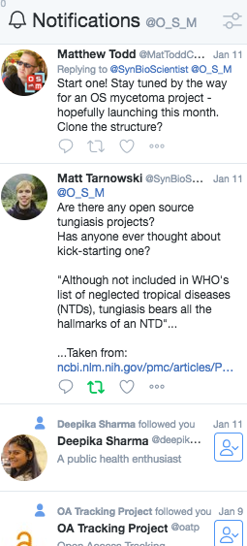
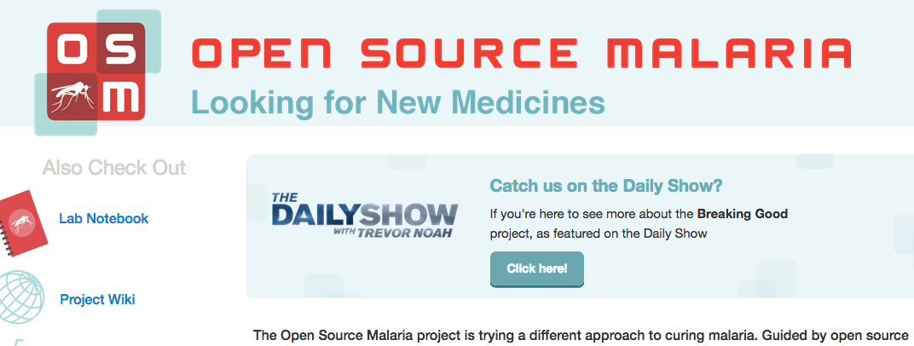
What Actually Is It?
19/58
Landing Page, SocMed
Need to be discovered, and to reach out to people.
http://opensourcemalaria.org/
@O_S_M

Slide 20
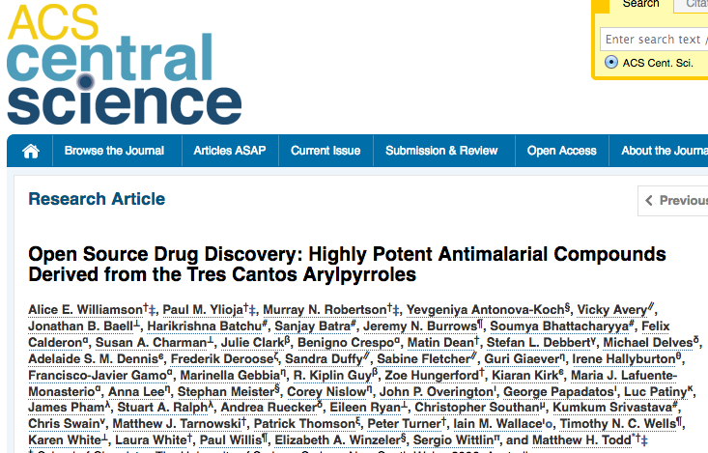
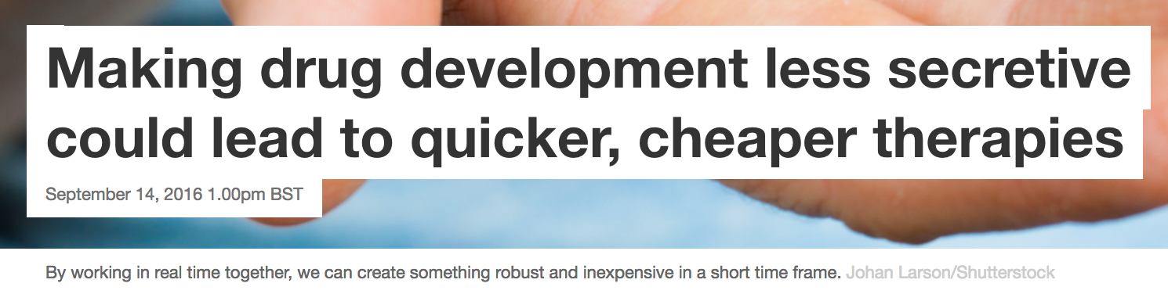
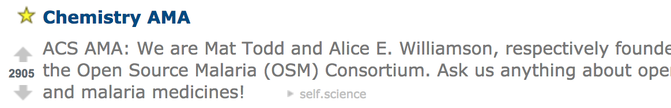
20/58
YES
…
you can publish
Paper: ACS Cent. Sci. 2016, 2, 687–701
Platform: Chem. Sci. 2015, 6, 1614–1629; Parasitology 2014, 141, 148–157
The Conversation, Sept 14th 2016
Reddit Ask Me Anything, Oct 4th 2016

Slide 21
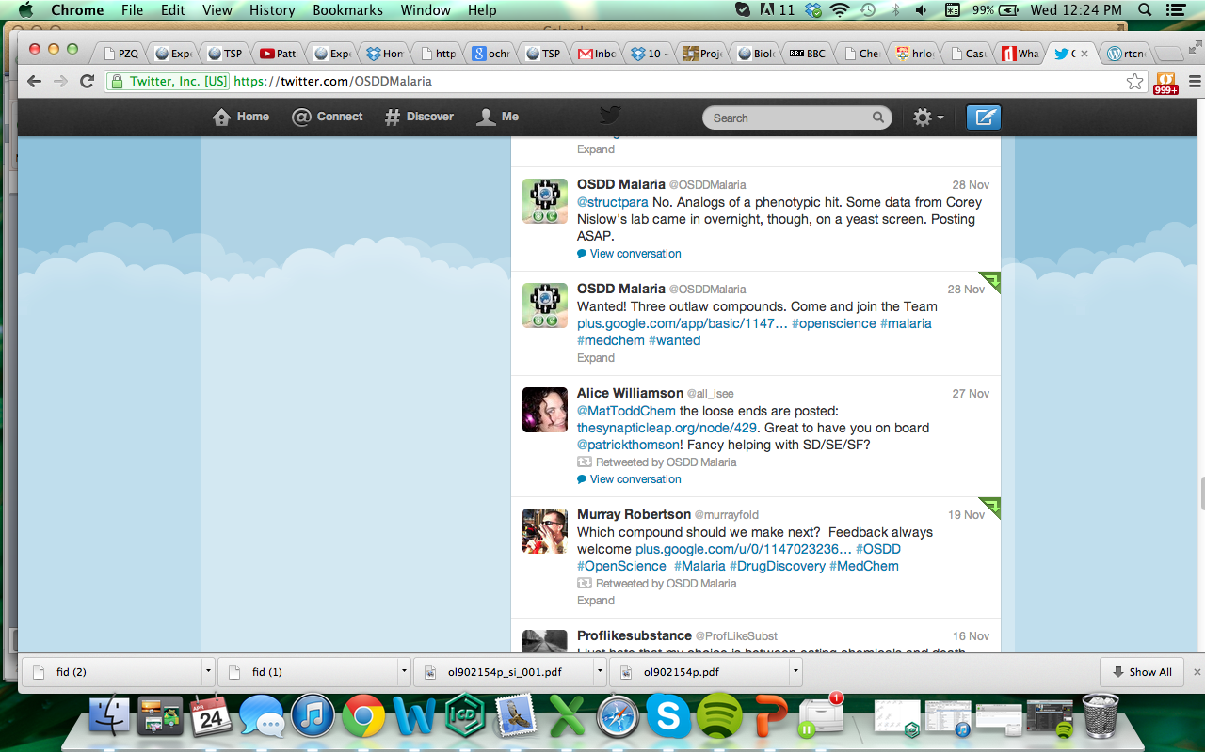
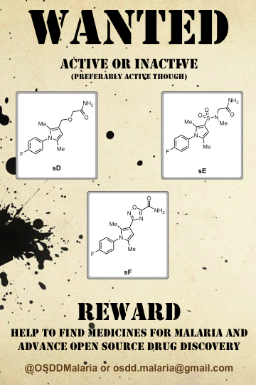
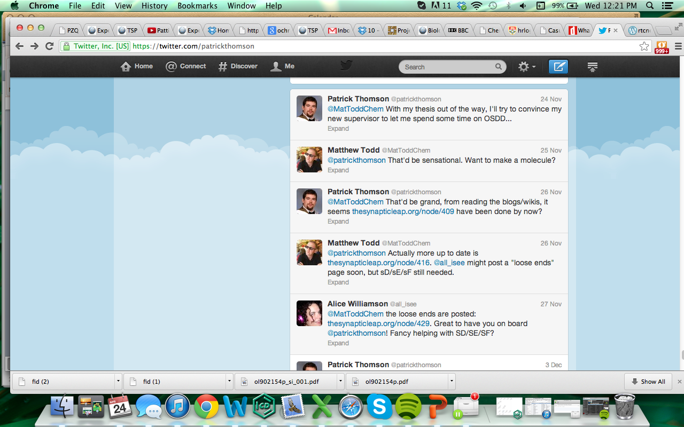
21/58

Slide 22
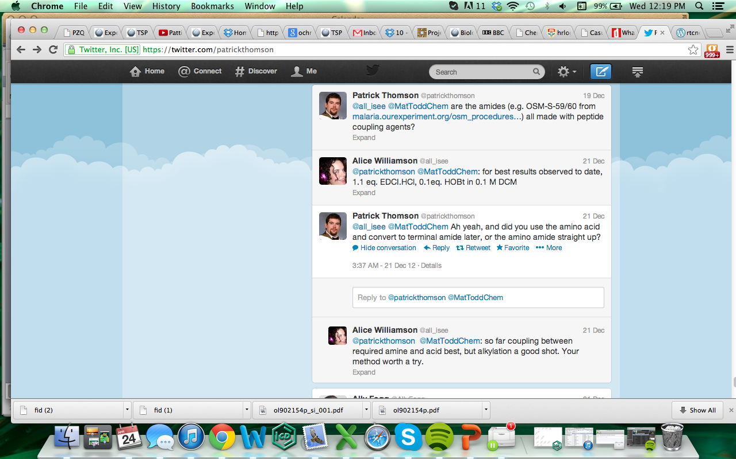
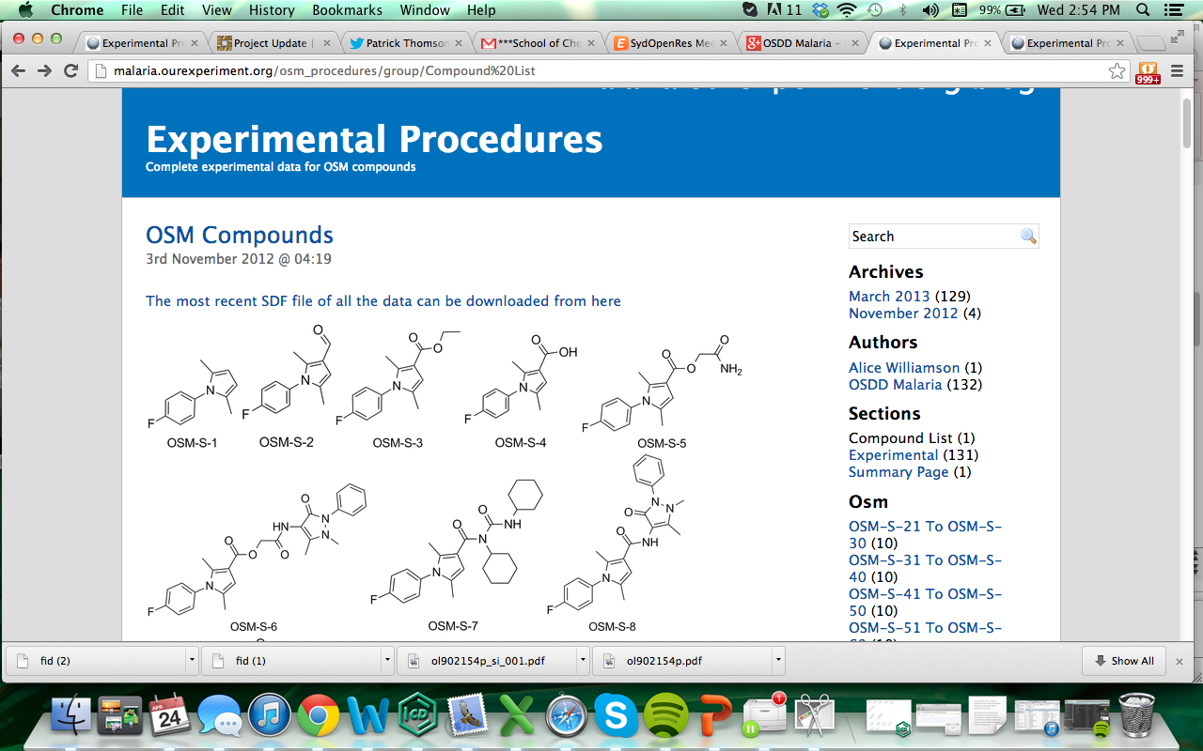
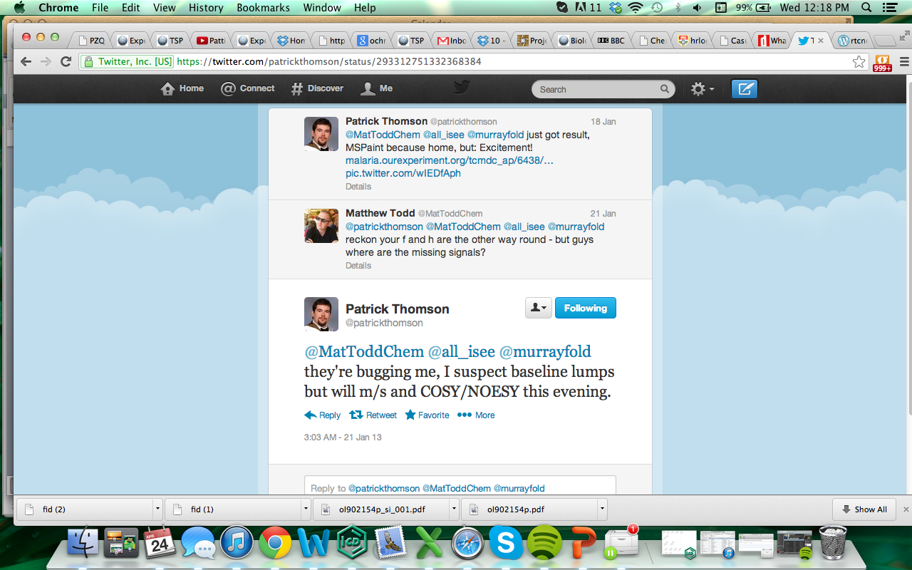
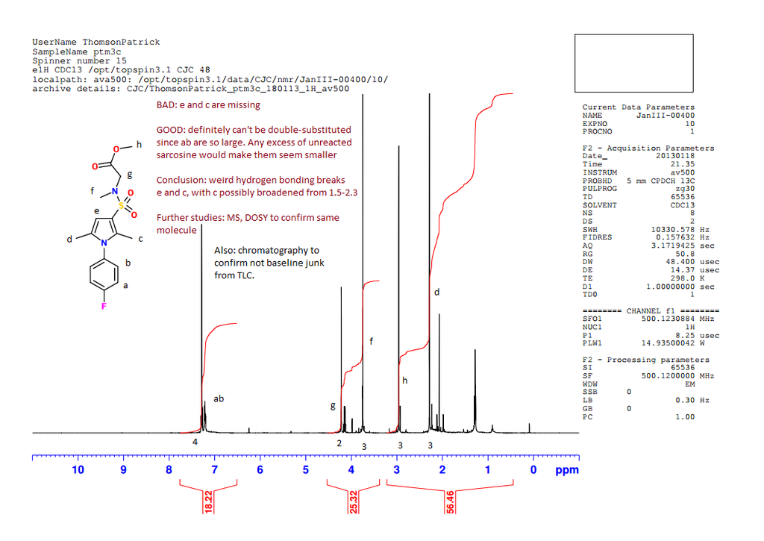
22/58

Slide 23
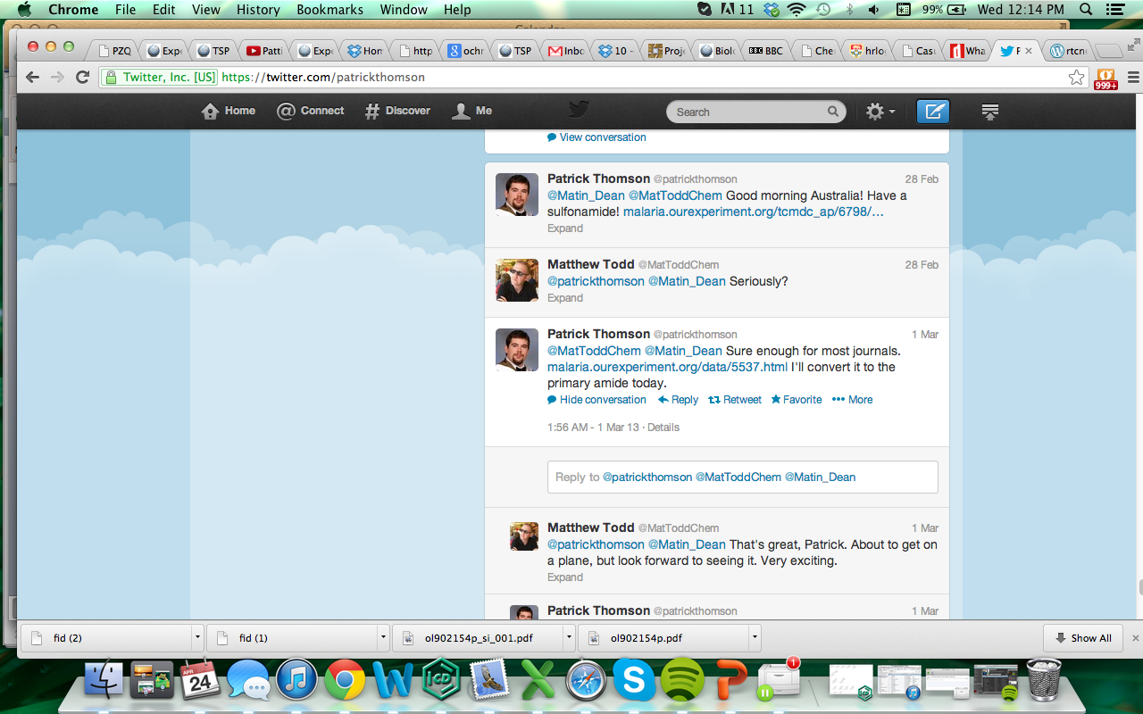
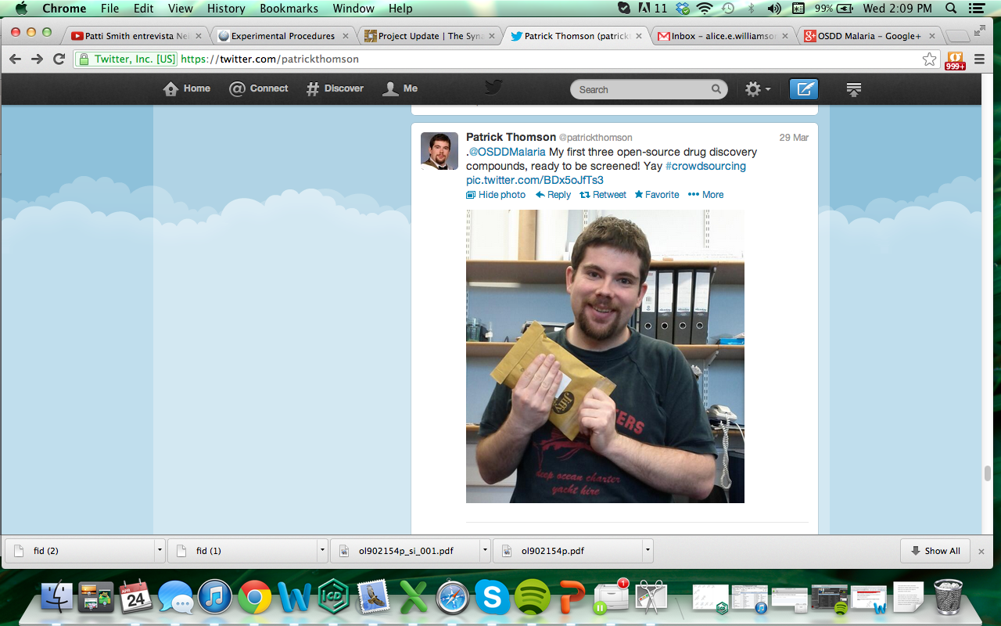

23/58

Slide 24





Example: Mechanism of Action
24/58
Current
The malaria parasite cation ATPase PfATP4 and its role in the mechanism of action of a new arsenal of antimalarial drugs
N. J. Spillman and K. Kirk,
Int. J. Parasitol. Drugs Drug Res. 2015, 5, 149–162
(10.1016/j.ijpddr.2015.07.001)
Kiaran Kirk
Adele Lehane
Adelaide Dennis
inactive
280 nM
356 nM
185 nM
114 nM
Whole-cell potency correlates with activity in ion regulation assay

Slide 25

One Lock, So Many Keys
25/58
http://malaria.ourexperiment.org/the_osm_blog/11547

Slide 26

26/58
In silico model of target, creation of resistance
Jimenez-Diaz et al. PNAS 2014, 111, E5455–E5462 (10.1073/pnas.1414221111)

Slide 27

27/58
Wisdom of the Crowd. Nearly.
17/18
Six models, all with different approaches
Different abilities to predict actives from unpublished dataset
Ranked, prizes awarded
All submitters want to work together to refine models openly
https://tinyurl.com/OSM-ToDo
#538

Slide 28


Big Inputs Come From Big Pharma
28/58
17/18
Scott Obach, Pfizer
https://tinyurl.com/OSM-ToDo
#513

Slide 29
SNAFUs Handled in Public View
29/58
17/18

Slide 30


30/58
Example Input. Vito Spadavecchio
Docked with pCLK1
June 3rd 2017
Vito knows the inputs are needed, now
They can change the direction of the project and may be acted upon
They are accompanied by full details of methods used
They are provided freely, without complex contractual negotiations
They are good, and are immediately valued
Vito works in the private sector
Vito can walk away tomorrow if he wishes
Efficient from point of view of funding agencies
https://github.com/OpenSourceMalaria/OSM_To_Do_List/issues/503

Slide 31

31/58
Highly amenable to
Crowdsourced, Open Educational Initiatives
Nov ’12
Apr ‘13
Nov ‘14
Feb ‘15
Oct ‘15
Mar ‘16
Jun ‘16
’18 –

Slide 32



“Breaking Good”
32/58

Slide 33
Current sub-100 nM hits
33/58

Slide 34
Most Recent Physchem/Clearance Data
34/58
Series 3

Slide 35





Currently in OSM-Sydney
35/58
David Smith
Marat Korsik
Ed Tse
Tha Bhebhe

Slide 36
Current Target and Status
36/58

Slide 37

Trust as Transparency
37/58
https://commons.wikimedia.org/wiki/File:HK_TST_Chung_King_%E6%B4%BB%E6%96%B9%E5%95%86%E5%A0%B4_Woodhouse_Japanese_restaurant_Jika_Udon_open_kitchen_window.JPG

Slide 38

Spectatorism, engagement
38/58
https://upload.wikimedia.org/wikipedia/commons/3/39/MITO_Orchestra_Sinfonica_RAI.jpg

Slide 39
39/58
Next Targets for OSM
17/18
Specific
Scientific: Series into Preclinical Trials
Community: More official industry pro bono
Crowd: Federated/franchised student projects in synthesis
Content: Community-contributed “parked” or “static” series
Platform: many technical things
Broader Investments
Regulatory Superstructure
Other Disease-specific Projects
Scalable Crowd Management

Slide 40
40/58
What Are We Looking For Today?
17/18
New or parked series, to immortalise
People/companies interested in demonstrating expertise
People interested in economics of drug development
Willing AIs

Slide 41


41/58
Machine-readability of Whole Project…

Slide 42


…Helps People Make Connections
42/58
17/18
What you’re working on
connects to
What else is out there
It’s called
The Science Introduction Robot
or, umm,
SCINDR
Research Ideas and Outcomes 2: e9995 (27 Jul 2016). DOI: 10.3897/rio.2.e9995
Luc Patiny’s lab notebook C6H6: Mag. Res. Chem., 2017 in press. DOI: 10.1002/mrc.4669

Slide 43

Example of What Else is Missing
43/58
Over-arching problem: the platform doesn’t understand molecules
Useful. Understands an object.
Blah blah MOL#56 blah blah
Github performs lookup from Master Molecule List.
Understands, and inserts metadata

Slide 44

Set the Stage, but Don’t Have This:
44/58
17/18

Slide 45




AI Participant
45/58
An AI participant in open source drug discovery:
acts as a proving ground of tech
and check on project data quality

Slide 46





Semi-effectively, over at OSTB
46/58
Series 1
opensourcetb.org
@opensourceTB
http://openwetware.org/wiki/OpenSourceTB
http://tinyurl.com/OSTBCompounds
Google+ discussion community
Github: https://github.com/OpenSourceTB
opensourcetb@gmail.com
Series 2
PLOS ONE 2014, 9(12): e111782; J. Baiget, M. Alonso, J. Castro-Pichel and M. H. Todd, Unpublished 2018

Slide 47

New: OS Mycetoma
47/58
1. The Drugs for Neglected Diseases Initiative (DNDi) considers open source as best option
2. First screen has yielded first new hits
3. Feb: started new open source campaign
CENSORED
https://upload.wikimedia.org/wikipedia/commons/thumb/5/59/Madura_foot..JPG/1024px-Madura_foot..JPG

Slide 48


48/58
Fenarimols: A New Hope?
Now published: PLoS NTD 2018, 12(4): e0006437.

Slide 49



Maybe not…
49/58
https://github.com/OpenSourceMycetoma/Series-2-Aminothiazoles

Slide 50


50/58
Patents Aren’t Necessary
Penicillin, The Polio Vaccine
ASAQ/Coarsucam
Bompart F, Kiechel JR, Sebbag R, Pecoul B (2011) Innovative Public-Private Partnerships to Maximize the Delivery of Anti-malarial Medicines: Lessons Learned from the ASAQ Winthrop Experience. Malaria Journal 10:143. doi:10.1186/1475-2875-10-143
Fexinidazole
Torreele E, Bourdin Trunz B, Tweats D, Kaiser M, Brun R, Mazué G, et al. (2010) Fexinidazole – A New Oral Nitroimidazole Drug Candidate Entering Clinical Development for the Treatment of Sleeping Sickness. PLoS Negl Trop Dis 4(12): e923. doi:10.1371/journal.pntd.0000923

Slide 51



51/58
Application to … Pharma?
US$3M awarded to me and 4 colleagues in 2015 for creation of Open Source Pharma Foundation. Money to be spent in India to support any open work. Now incorporated, commencing activities.
PLoS Med. 2017, 14(4): e1002276
The Guardian, April 19th 2017

Slide 52




52/58
Other Financial Models in Pharma
Independent Mobilization of Donor Funds
Advance Market Commitments & International Financing Facilities
R. Atun, F. M. Knaul, Y. Akachi and J. Frenk, Lancet 2012, 380, 2044–2049
Levy on Airline Tickets

Slide 53






53/58
Other Financial Models in Pharma II
Priority Review Vouchers
P. Doshi, BMJ 2014, 349:g4665. DOI: 10.1136/bmj.g4665
Prizes
A. Banerjee, A. Hollis and T. Pogge, Lancet 2010, 375, 166–169. DOI: 10.1016/S0140-6736(09)61296-4
Crowdfunding
J.-M. Fernandez, R. M. Stein and A. W. Lo, Nature Biotech. 2012, 30, 964–975. DOI: 10.1038/nbt.2374

Slide 54


54/58
An Overlooked Strategy
Diverse Funding of Open Source Drug Discovery
|
Make Money Back
|
Drug Goes Generic

Slide 55



55/58
Some Family History
A financial reward in proportion to contribution,
after demonstration of effectiveness
Samuel Crompton
1753–1827
https://upload.wikimedia.org/wikipedia/commons/f/fd/Mule-jenny.jpg
https://en.wikipedia.org/wiki/Samuel_Crompton#/media/File:Samuel_Crompton_portrait.jpg

Slide 56



56/58
Inclusiveness: Future Role of Private Sector
“…organizations of all types are increasingly taking advantage of the many benefits open source can bring in terms of cost-effectiveness, better code, lower barriers of entry, flexibility, and continual innovation.”
World Bank Blog https://blogs.worldbank.org/, Vivien Deparday, June 2017
“We conservatively estimate GFDRR’s return on investment (ROI) for GeoNode to have been at least 200% — with an emphasis on “conservative”. … the long-term and indirect ROI is much greater than that, and continues to grow”
A Case Study on Institutional Investments in Open Source, World Bank and Global Facility for Disaster Reduction and Recovery (GFDRR), 2017
$371M VC investments in OS software in Q1 2017 alone
Jason Rowley, CrunchBase, April 2017

Slide 57




57/58
New Problems Need Radical Approaches

Slide 58







Sydney: Alice Williamson, Ed Tse, Michael Woelfe, Paul Ylioja, Murray Robertson, David Smith, Kat Badiola, Jimmy Cronshaw, Zoe Hungerford, Laura White, Clara Chen, Angela Butera, Matin Dean, Althea Tsang, Jo Ubels, Tom MacDonald, Matt Tarnowski, Peter Turner, Carmen Tran, Inga Topolnicki, Haochuan Mao, Tianyi Zheng, Jasper Tyler, Mathamsanqa Bhebhe, Marat Korsik MMV: Tim Wells, Paul Willis, Jeremy Burrows GSK: Javier Gamo, Felix Calderon, Lluis Ballell, Julia Castro-Pichel, Carlos Alemparte, Benigno Crespo Sydney Grammar School: Malcolm Binns, Erin Sheridan, the boys WHO/TDR: Piero Olliaro Syncom B.V.: Jean-Paul Seerden Massachusetts College of Pharmacy and Health Sciences: Chase Smith and students Dundee: Irene Hallyburton Southampton: Jeremy Frey and team ChEMBL: John Overington, Iain Wallace, George Papadatos ANU: Kiaran Kirk, Adele Lehane, Adelaide Dennis OSDD India: Sanjay Batra, Soumya Bhattacharyya Griffith: Vicky Avery, Sandra Duffy, Sabine Fletcher, Mark Coster and student teams Monash: Sue Charman, Karen White, Darren Creek, Anubhav Srivastava Melbourne: Stuart Ralph, James Pham Basel: Sergio Wittlin Edinburgh: Patrick Thompson, Eduvie Omene, Devon Scott, Tom Foley Pfizer: Scott Obach, Christine Orozco Lawrence University: Stefan Debbert and students Haverford College: Robert Broadrup Karolinska Institute: Sabin Llona-Minguez University of British Columbia: Corey Nislow, Marinella Gebbia, Anna Lee Asclepia: Frederick DeRoose ExScientia: Willem van Hoorn UCSD: Stephan Meister, Elizabeth Winzeler St Jude’s Hospital: Kip Guy, Julie Clark Other Online: Chris Southan, Jonathan Baell, Chris Swain, Egon Willighagen, Vito Spadavecchio, Mandrake Fernflower, Ho Leung, and many others

